Slide 1
Dungeon of the Mighty Titan - Vanquish (DMT-V)
Data Dictionary 🌑 Data Model 🌑 Algorithm Analysis

Slide 2
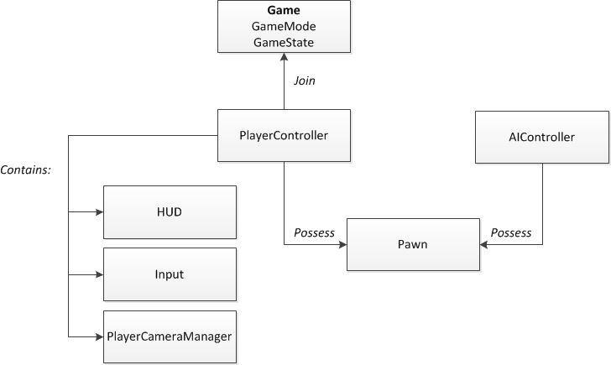
High Level Interaction
https://docs.unrealengine.com/latest/images/Gameplay/Framework/QuickReference/GameFramework.jpg

Slide 3
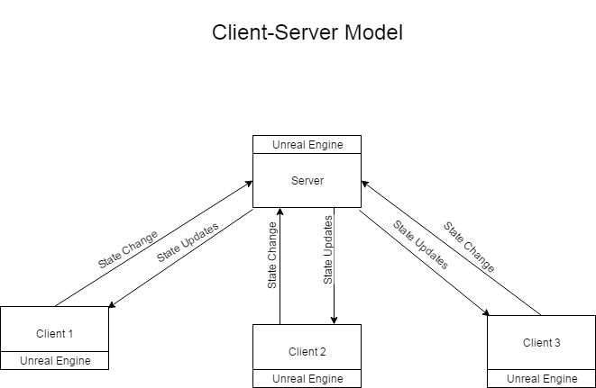

Slide 4
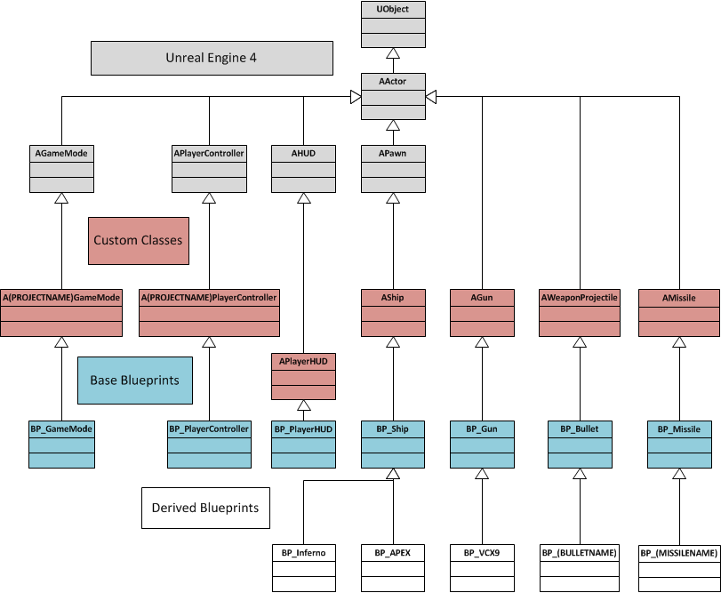
Example Class Hierarchy
https://brodyhiggerson.files.wordpress.com/2014/08/blueprinthierarchy.png

Slide 5
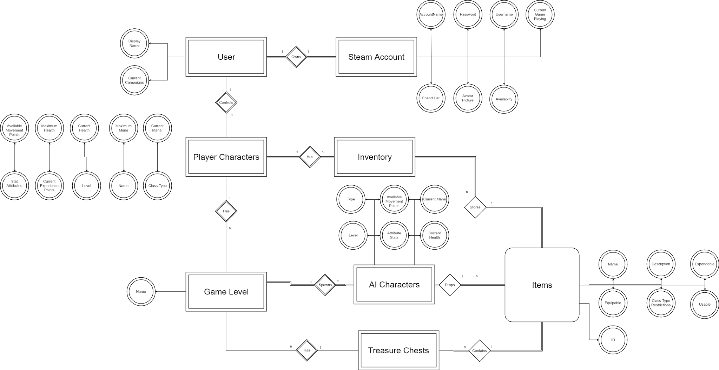
Data Model

Slide 6
Data Dictionary
Field Name | Data Type | Constraint | Description
DungeonGameMode | AGameMode | not null | Defines the rules, players, and scoring metrics[5]
DungeonGameState | AGameStateBase | not null | Maintains the game state (Map, level, players, etc.)
DungeonPlayerControllers[] | PlayerController[] | non-empty collection | Collection of human-controlled players
DungeonAIController[] | AIController[] | non-empty collection | Collection of AI-controlled players
DungeonPawns[] | DefaultPawn[] | non-empty collection | Collection of Actors - Pawn is the base class for Actors[4]
DungeonPlayerStates[] | APlayerState | non-empty collection | Game state associated with each player to maintain and communicate relevant information to other clients
DungeonGameSession | AGameSession | not null | "Game Session handles login approval, arbitration, online game interface"[6]

Slide 7
Data Dictionary (continued)
Field Name | Data Type | Constraint | Description
damage | int | > 0 | reduction in opponent health
stats | struct | not null | data structure storing certain player attributes (?)
equipment | Items[] | not null | player's inventory (weapons, special items)
target | PlayerController | not null | the player receiving an attack
strength | enum | not null | attribute that is most developed
weakness | enum | not null | attribute that is least developed
luck | int | > 0 | Player attribute: luck

Slide 8
Data Dictionary (continued)
Field Name | Data Type | Constraint | Description
class | enum | not null | Defines the class of character
position_x | int | >0 | Defines player's x coordinate on the game map
position_y | int | >0 | Defines player's y coordinate on the game map
strength | int | >0 | Player attribute: strength
vitality | int | > 0 | Player atrribute: vitality
intelligence | int | > 0 | Player attribute: intelligence
wisdom | int | > 0 | Player attribute: wisdom
dexterity | int | > 0 | Player attribute: dexterity
speed | int | > 0 | Player attribute: speed

Slide 9
Algorithm Analysis
Pathfinding Algorithm for AI.
Graph search algorithm
A* is utilized for the AI in the Advanced Turn-Based Tool Kit
A* is a modification of the Dijkstra’s Algorithm.
Dijkstra’s calculates lower cost in all direction
A* calculates lower cost in one direction.
Input = Start and End Goal
Output = Path with the shortest cost
Time Complexity: O(b^{d}) - where b is the average number of successors per state, while d is the depth of the shortest path.

Slide 10
A* vs Dijkstra
*Both extracted from “Red Blob Games”

Slide 11
Algorithm Analysis (continued)
PlayerQueue
Fixed-size array of PlayerControllers, sorted by movement speed of the player. The fastest player moves first.
Time Complexity: O(1) or constant - The contents of the array will be accessed directly using an index
Space Complexity: O(N) or linear - Size of the array will grow linearly with each additional player added

Slide 12
Algorithm Analysis (continued)
AI Queue
Randomized array that holds the different AI controllers
Time Complexity: O(1) - Predetermined order of AI controllers will be in a queue
Space Complexity: O(n) - This depends on how many AI characters are required per level.

Slide 13
Works Cited
“Red Blob Games.” Introduction to A*.N.p., 26 may 2014. Web 28 Feb.2017.

